Slide 1
DATA607 - COVID Data
Josh Iden and Jawaid Hakim

Slide 2
Motivation
Use COVID-19 datasets to explore global pandemic stats
Explore relationships between COVID-19 prevalence and other datasets, e.g. mask policies, S&P500

Slide 3
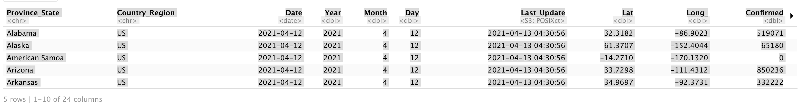
Data Acquisition - JHU CSSE USA Daily Data
US Daily

Slide 4
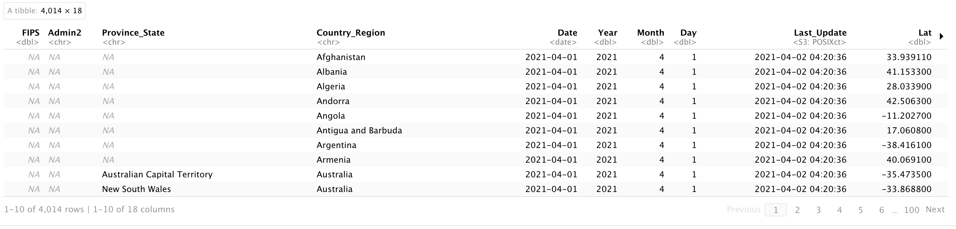
Data Acquisition - JHU CSSE Global timeseries
Global Timeseries

Slide 5
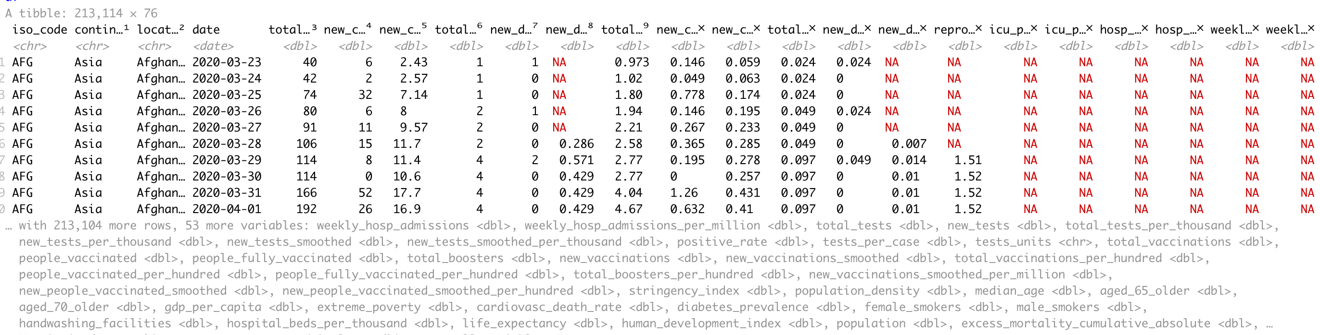
Data Acquisition - Our World In Data
OWID Comprehensive Timeseries

Slide 6
Data Wrangling - Strategy
Common data extraction scripts/functions across datasets
Parallel processing
Table extraction (scraping) from HTML using Selenium/readr
Spark cluster interface

Slide 7
Data Wrangling Milestones
Github API rate limits. Implemented OAuth authentication to access Github via a personal account for higher limits.
OWID dataset did not provide latitude/longitude variables. Downloaded a separate dataset with country lat/long and (left) joined with OWID for plotting on map

Slide 8
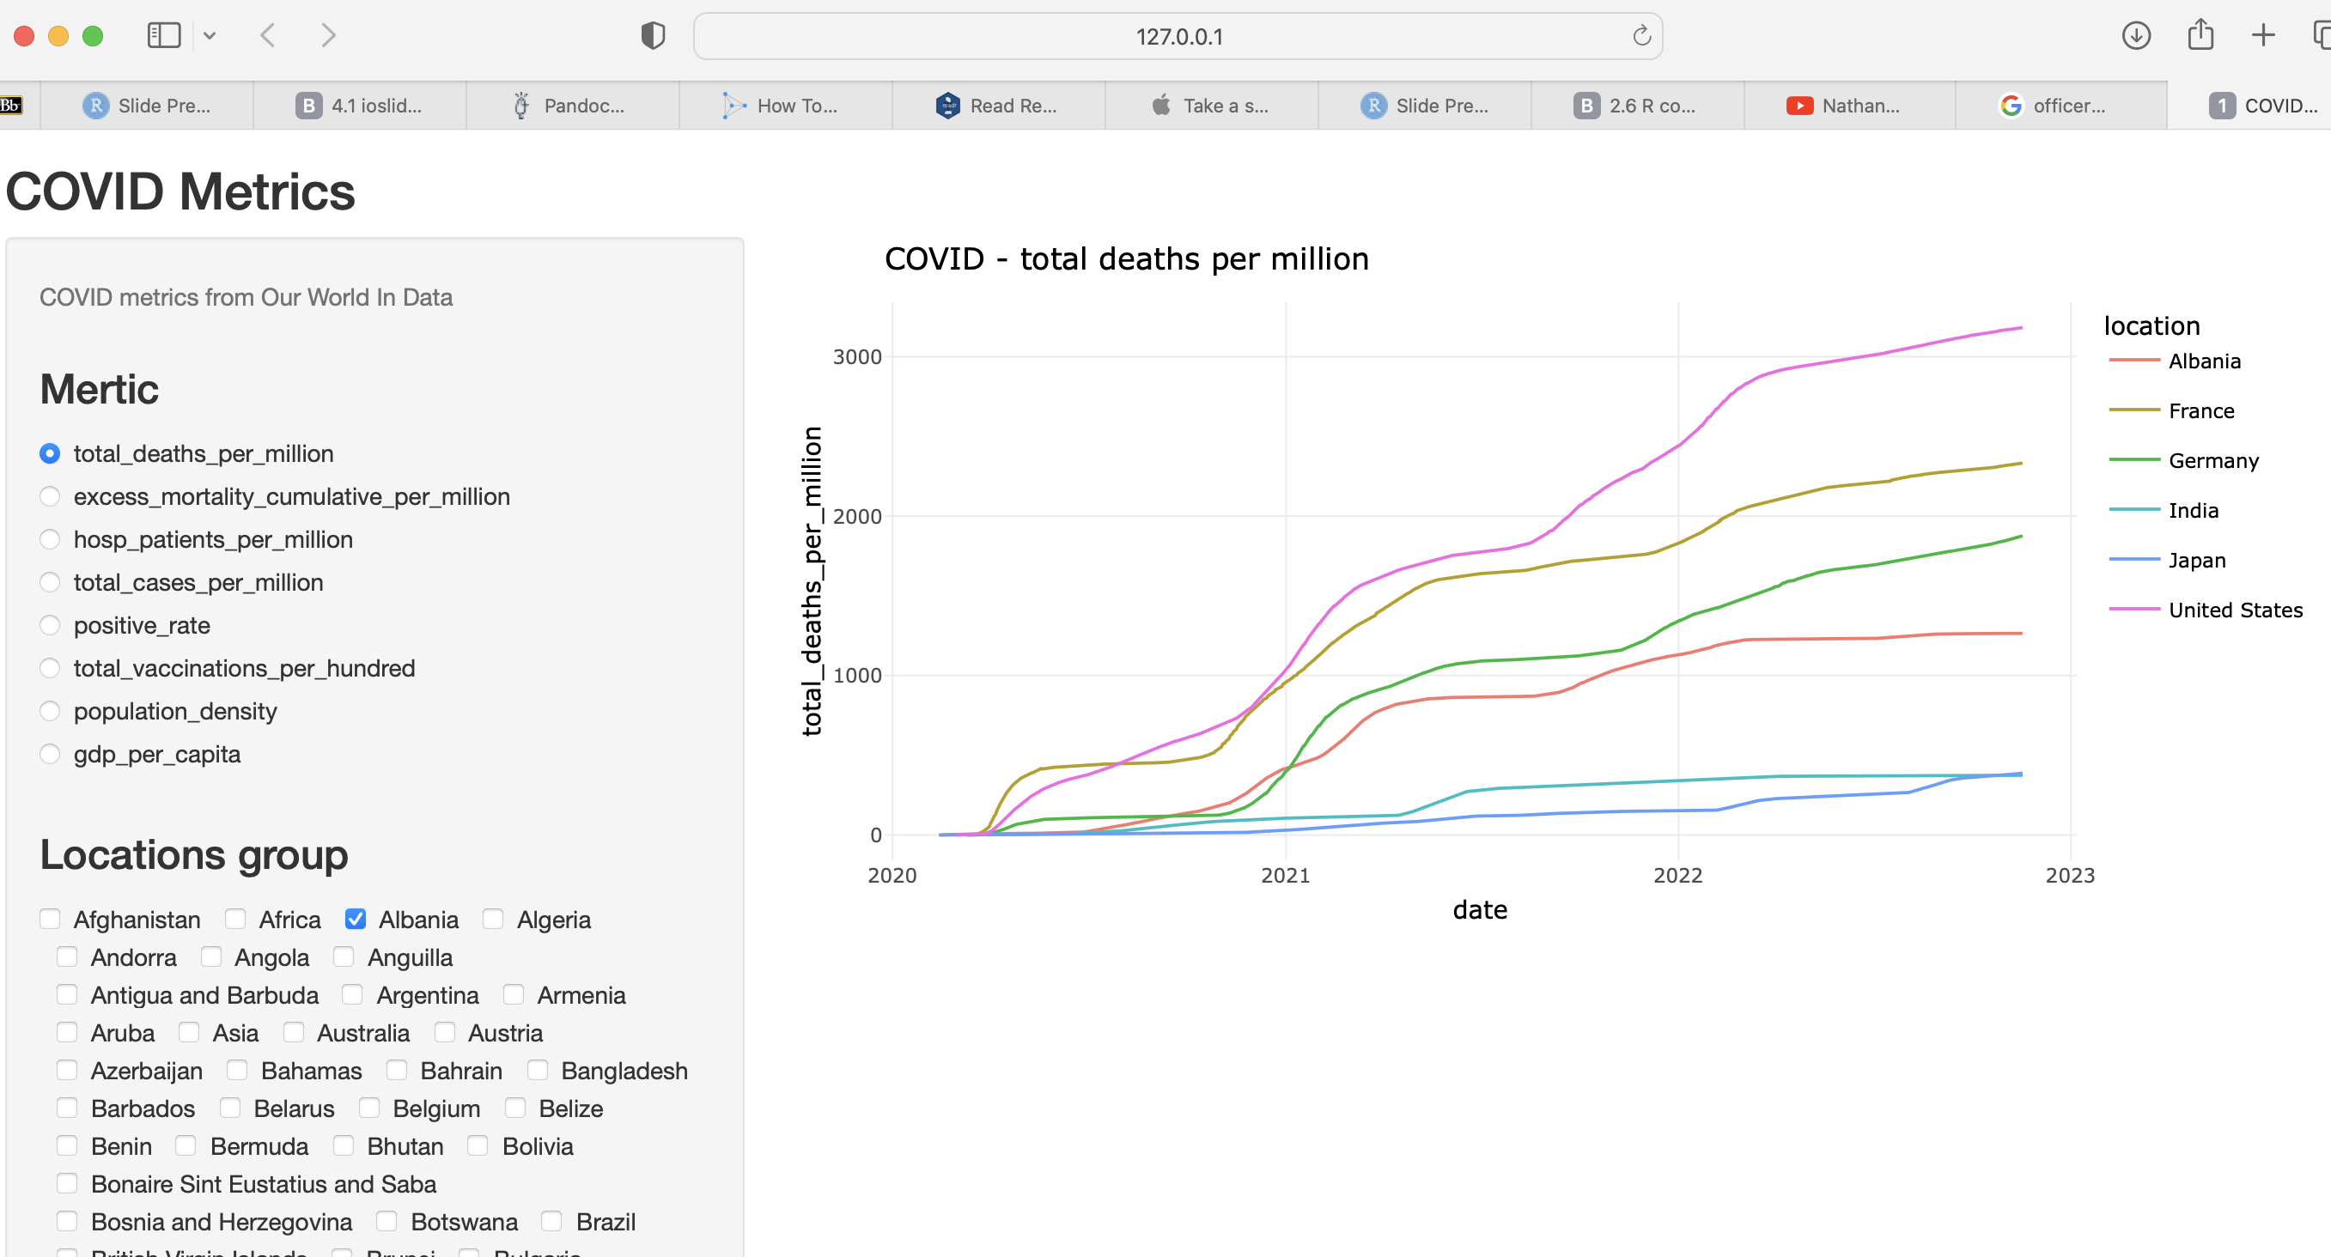
Shiny - interactive data exploration
OWID Comprehensive Timeseries

Slide 9
Click to launch Shiny App

Slide 10
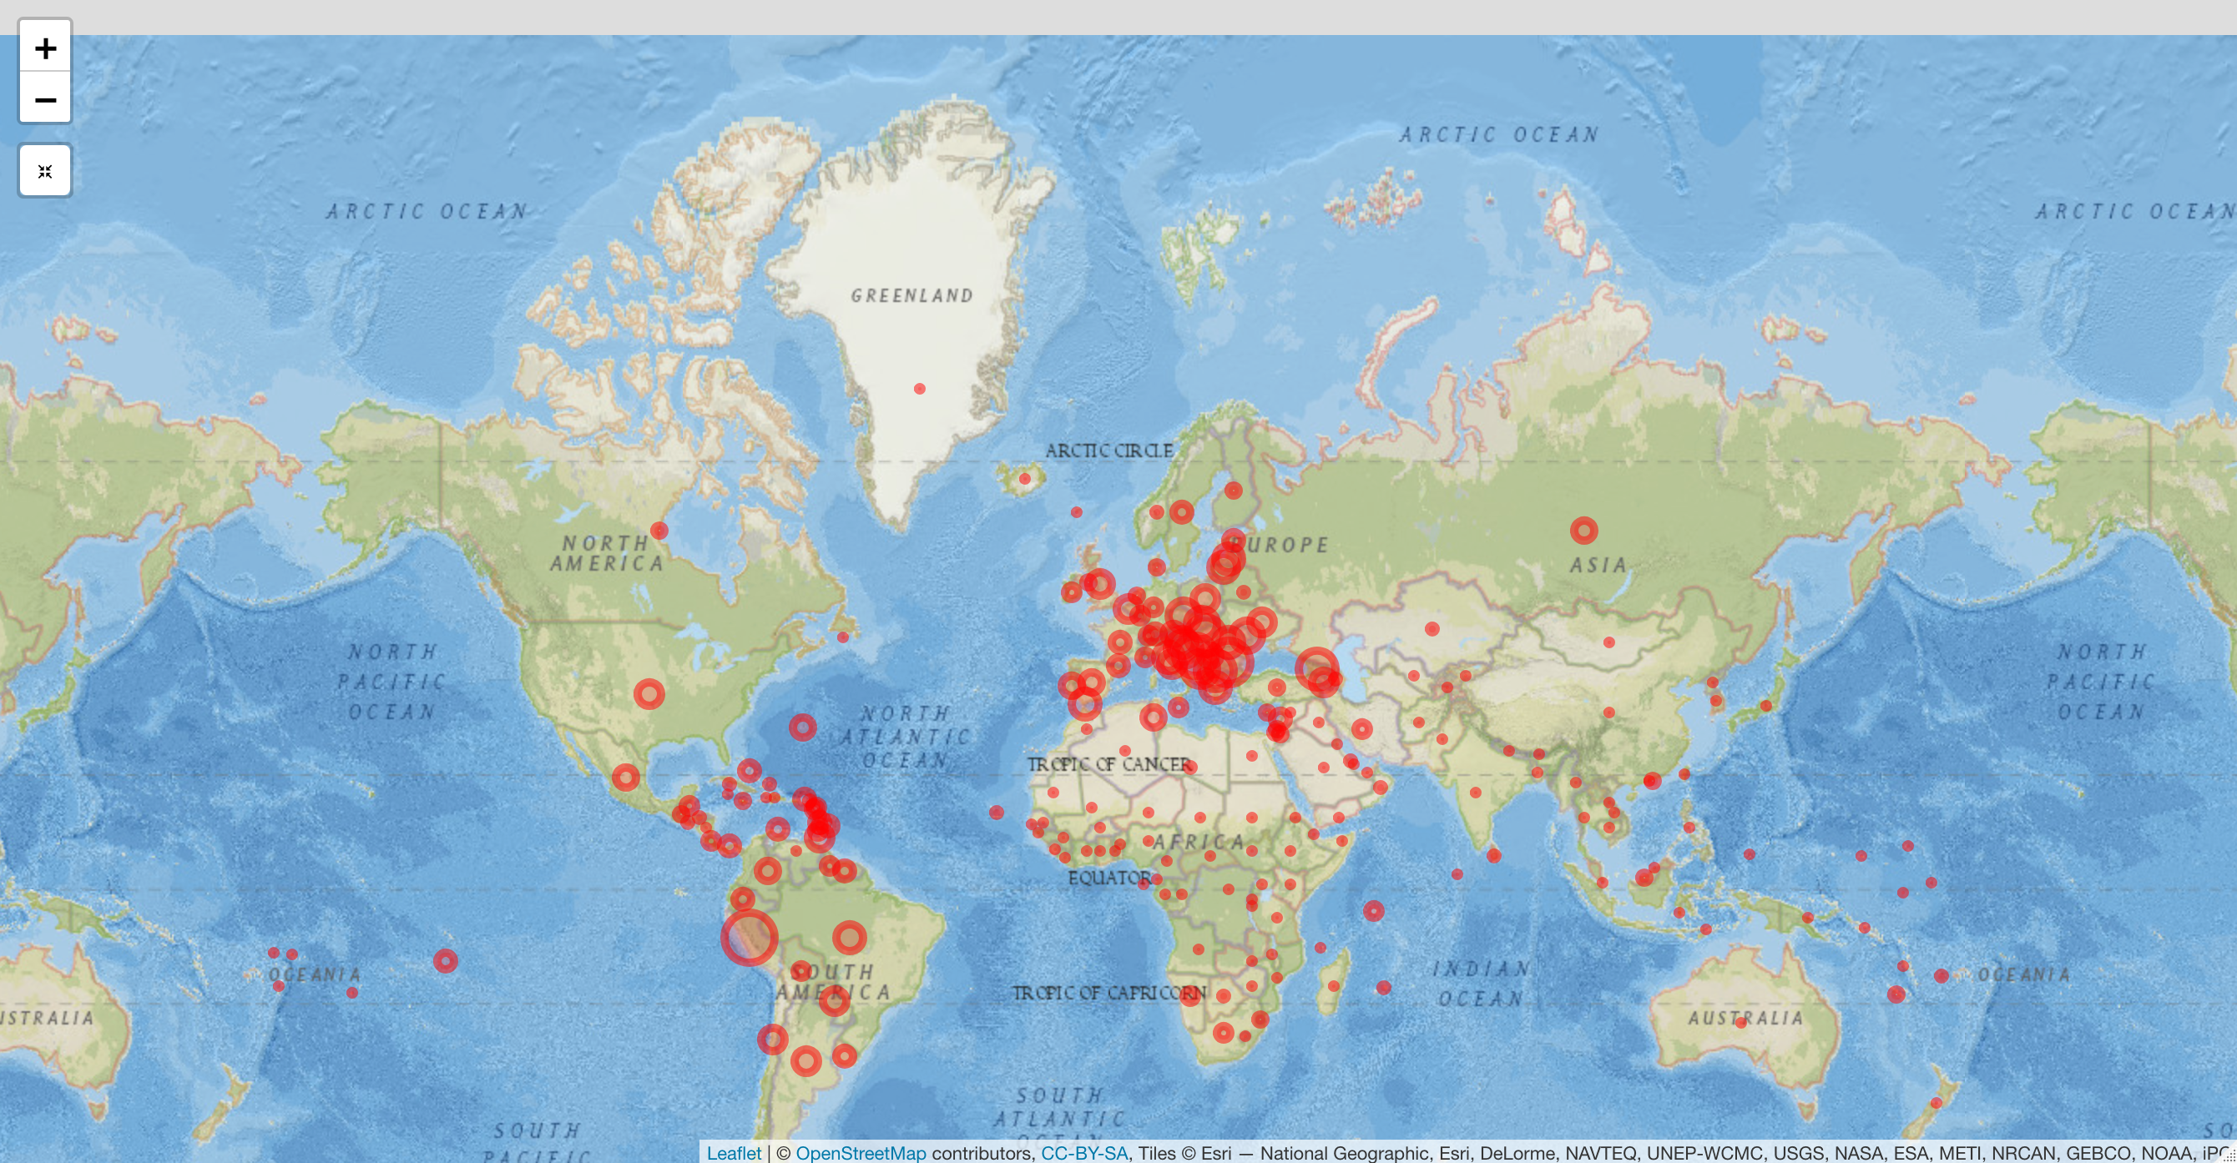
Leaflet - interactive map visualization
OWID Comprehensive Timeseries

Slide 11
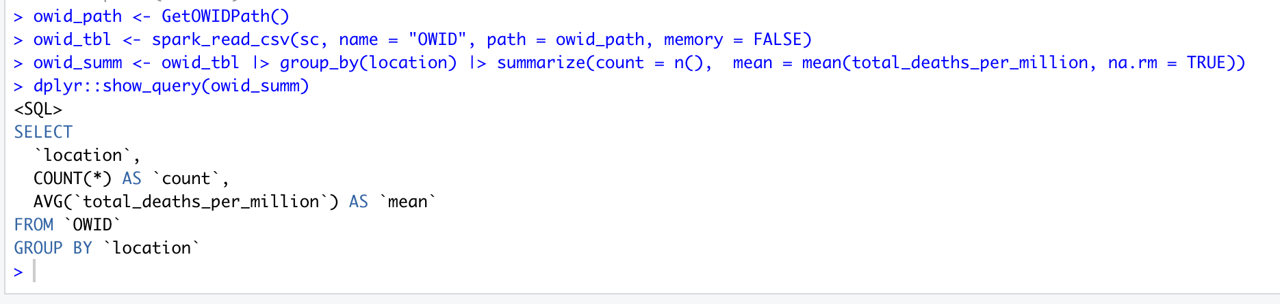
Spark - distributed (Scalable) query, analytics, ML
Spark - Query

Slide 12
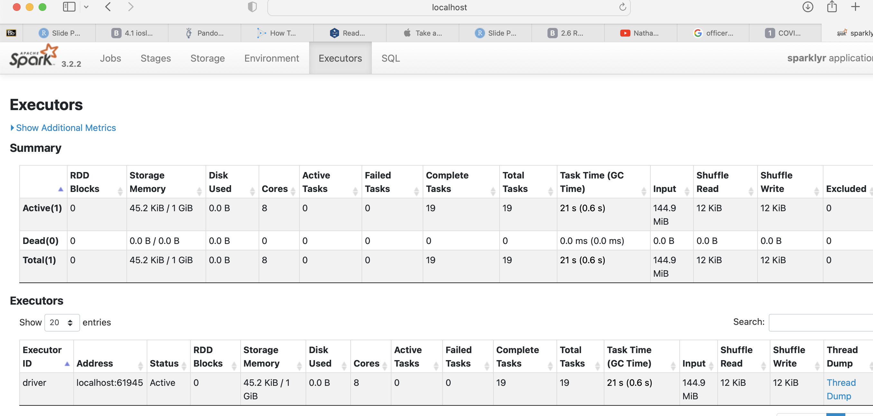
Spark - Executors

Slide 13
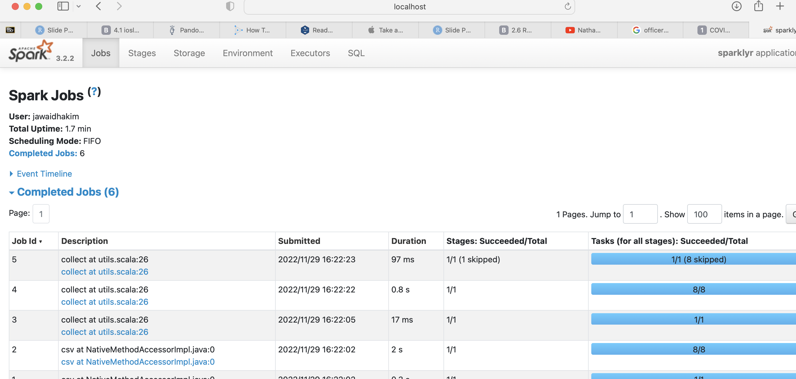
Spark - Completed Jobs

Slide 14
Tech Stack
Rselenium: headless browser for getting around embedded JavaScript
parallel: chosen for efficiently processing remote data files using a local cluster
readr: reading remote/local CSVs
Leaflet: interactive global map
Spark/sparklr: proof-of-concept Spark cluster. Cloud hosted Spark services are fee-based or time-limited - used local cluster
AWS S3: AWS S3 rate-limits made it impractical (20,000 GET Requests; 2,000 PUT, COPY, POST, or LIST Requests each month)

Slide 15
Exploratory Data Analysis

Slide 16
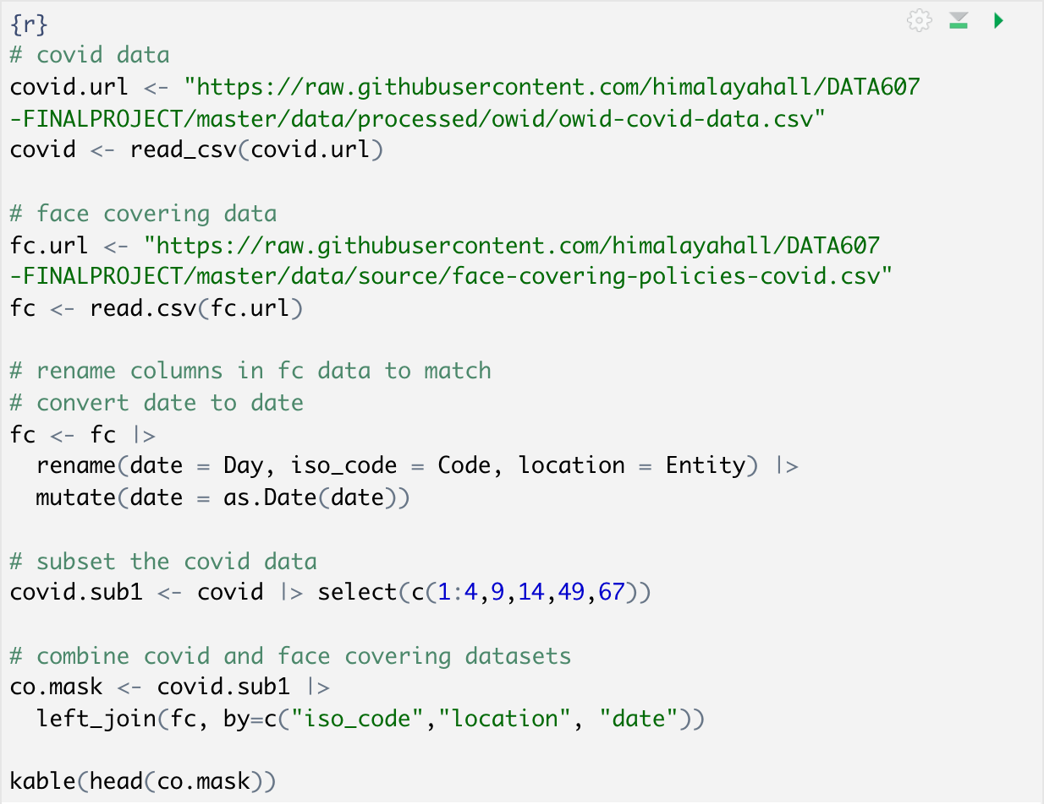
Combining the Covid and Mask Policy datasets

Slide 17
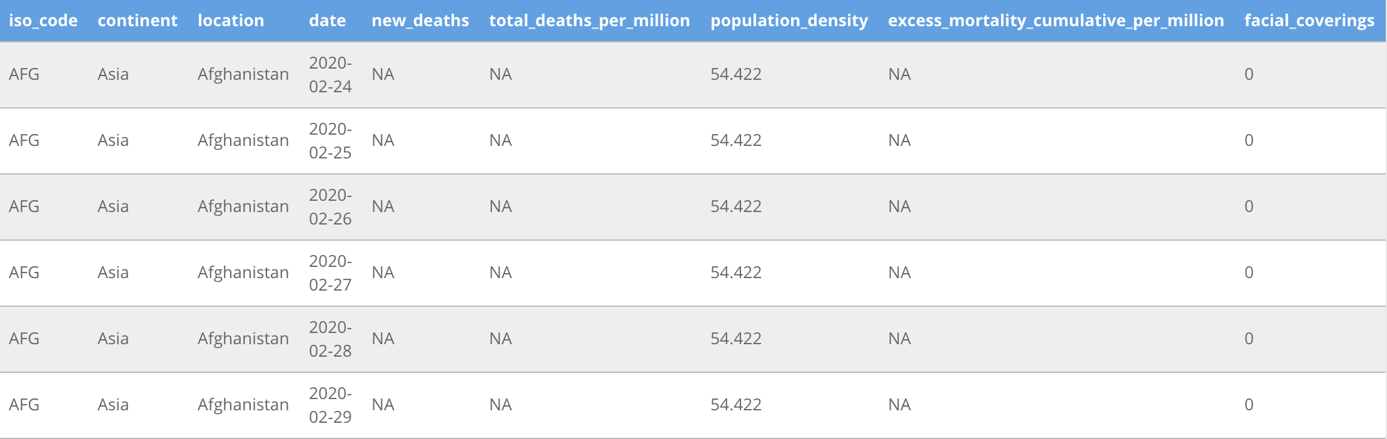
Combining the Covid and Mask Policy datasets (cont’d)

Slide 18
Face Covering Dataset
Source: https://ourworldindata.org/covid-face-coverings
Countries are grouped into five categories:
0 = No policy 1 = Recommended 2 = Required in some specified shared/public spaces outside the home with other people present, or some situations when social distancing not possible 3 = Required in all shared/public spaces outside the home with other people present or all situations when social distancing not possible 4 = Required outside the home at all times regardless of location or presence of other people

Slide 19
Face Covering Dataset (cont’d)
Aggregate - does not account for intra-country dynamics
Mask policy is typically in response to Covid outbreaks

Slide 20
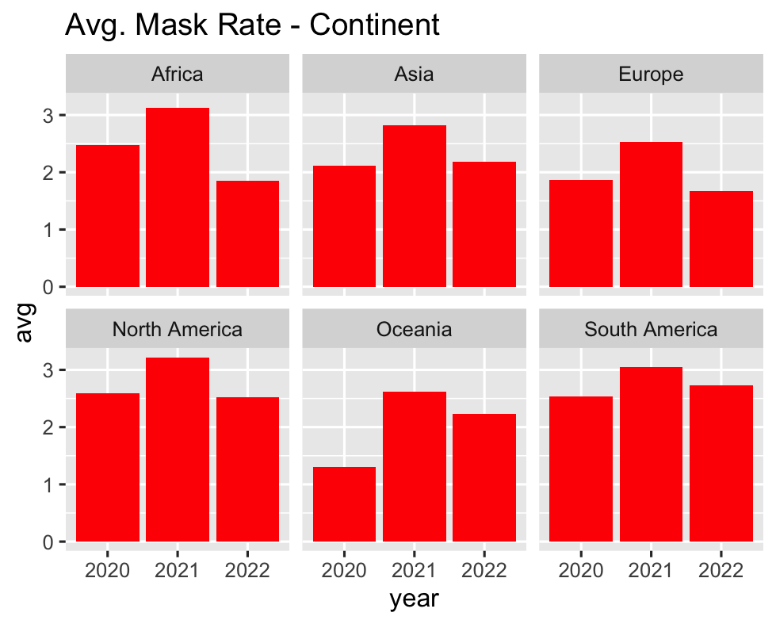
Avg. Mask Rates - Continent

Slide 21
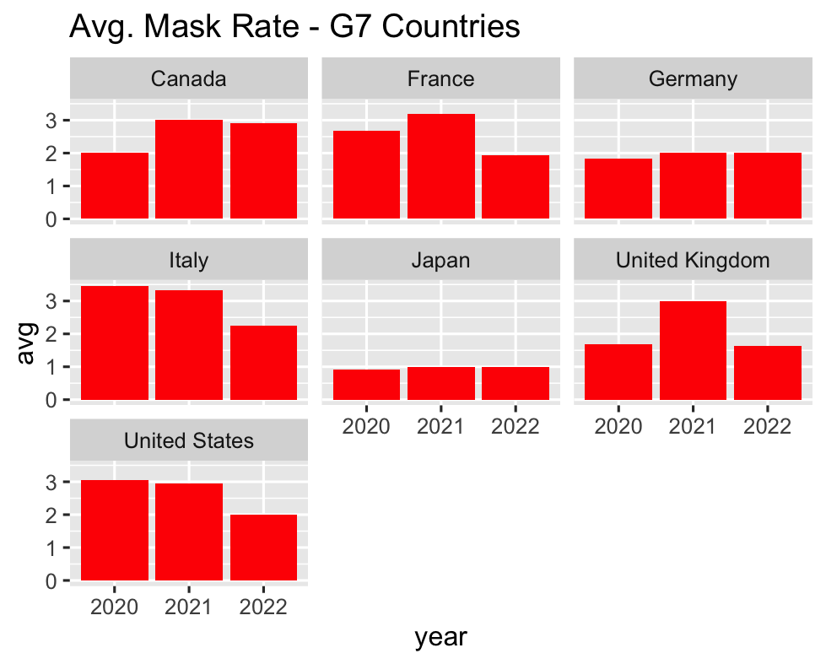
Avg. Mask Rates - G7

Slide 22
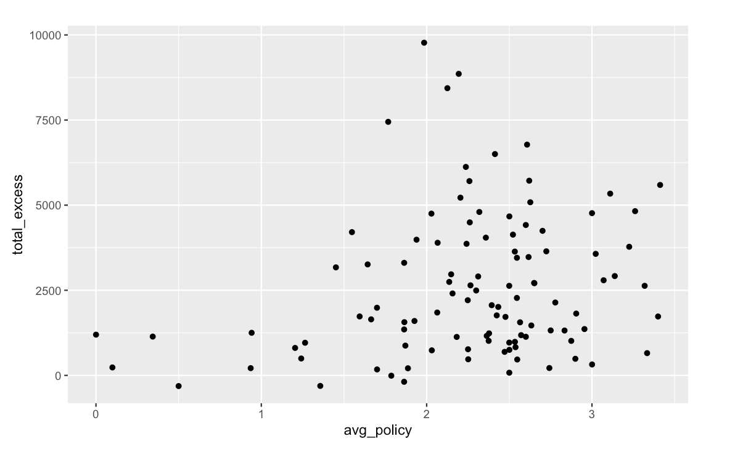
Excess Deaths by Avg. Mask Policy

Slide 23
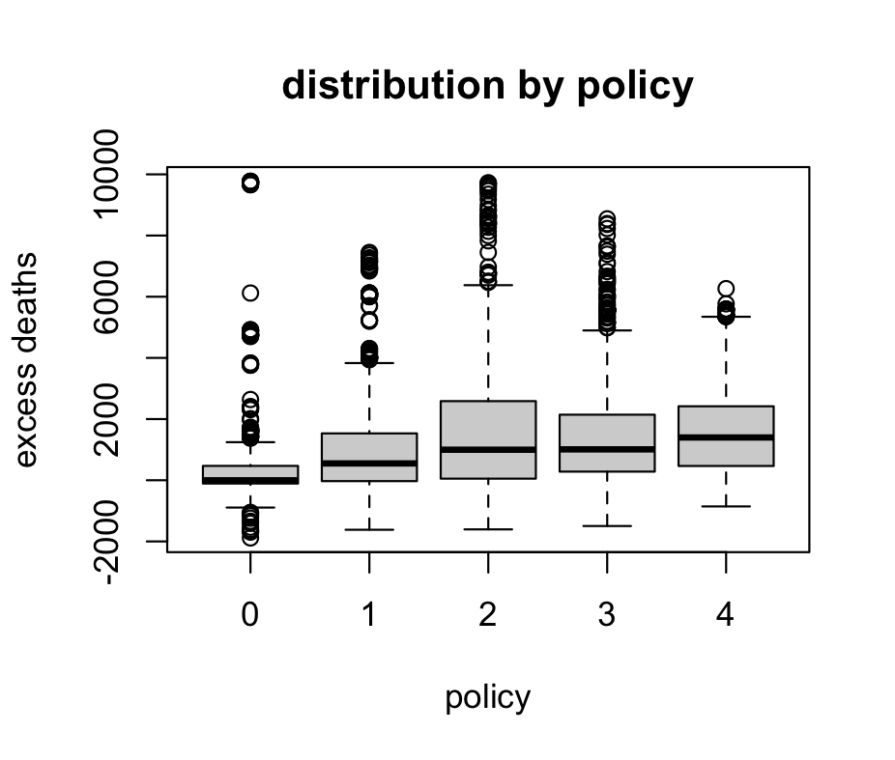
Excess Deaths by Mask Policy

Slide 24
Statistical Analysis
Does average mask policy predict total excess mortality?
The null hypothesis, $H_{0}$ - average mask policy does not predict total excess mortality.
The alternative hypothesis, $H_{A}$ - average mask policy does predict total mortality.

Slide 25
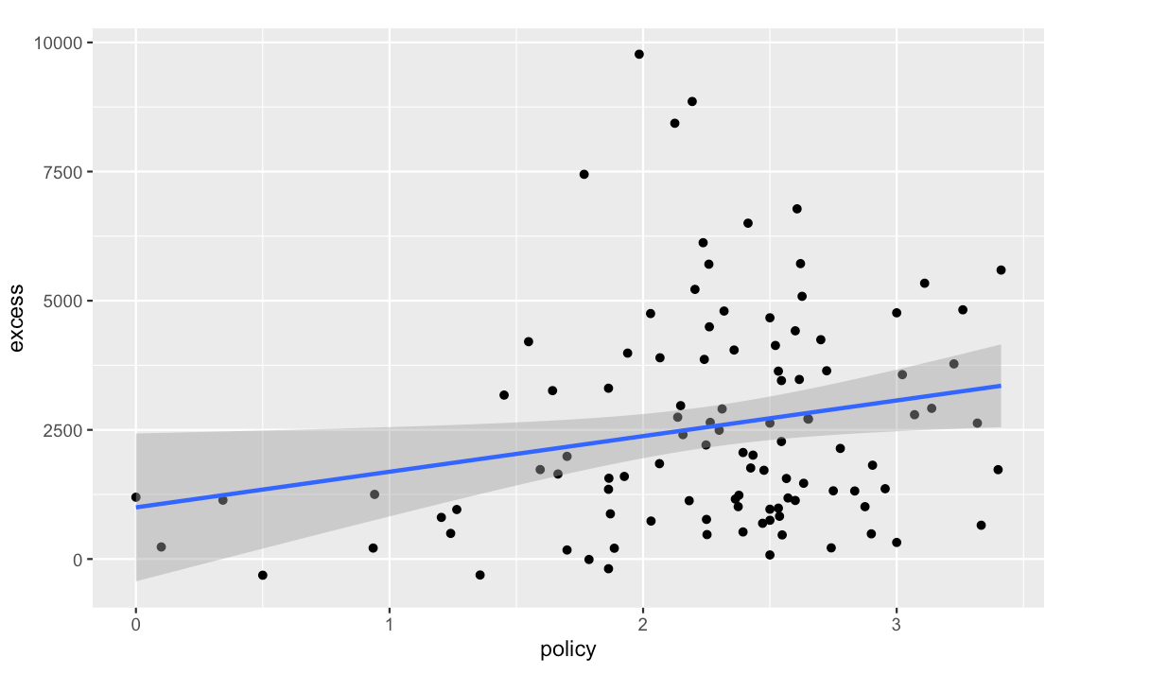
Relationship Between Mask Policy and Excess Death

Slide 26
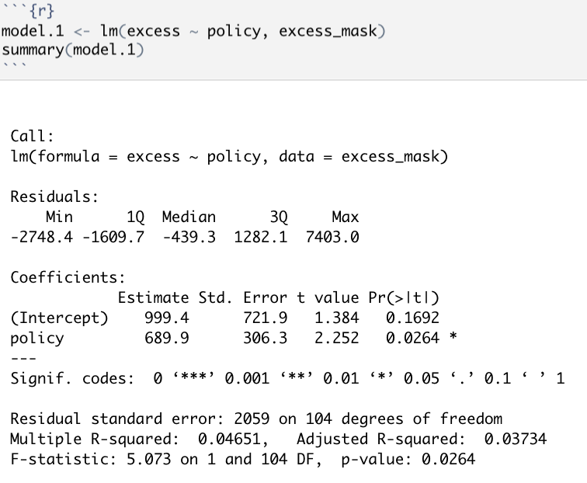
Fitting in a Linear Model

Slide 27
Interpreting the Model
p-value = 0.0264, significance
Adjusted R-squared = 0.037, accounts for very little variance

Slide 28
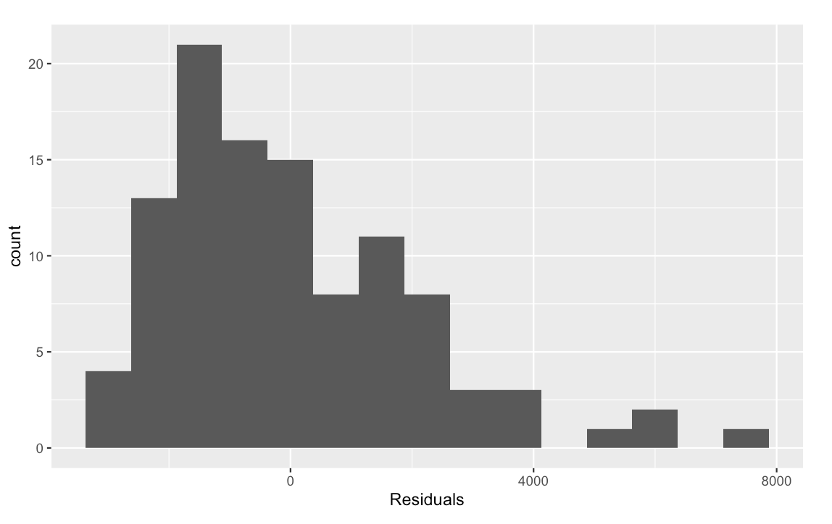
Residuals

Slide 29
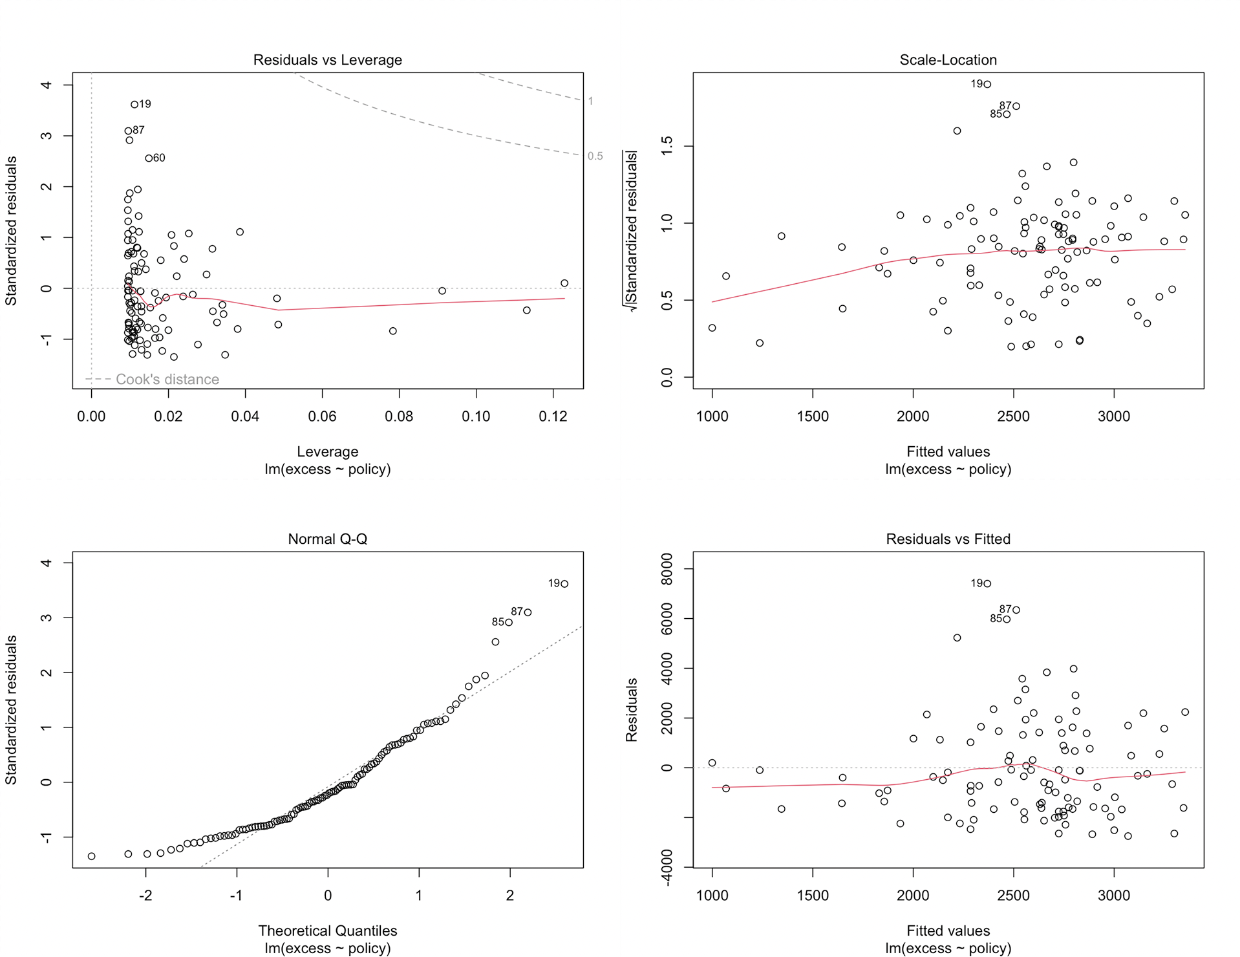
Residuals (cont’d)

Slide 30
Residuals (cont’d)
Linear
Non-Normal Distribution
Does Not Satisfy Homostedacticity (Non-Similar Variances)

Slide 31
Conclusion
Relationship exists
Not meaningful enough to predict
Possible reasons

Slide 32
Thank You!

